Slide 1
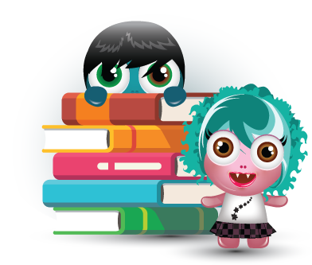
PARENT OVERVIEW

Slide 2
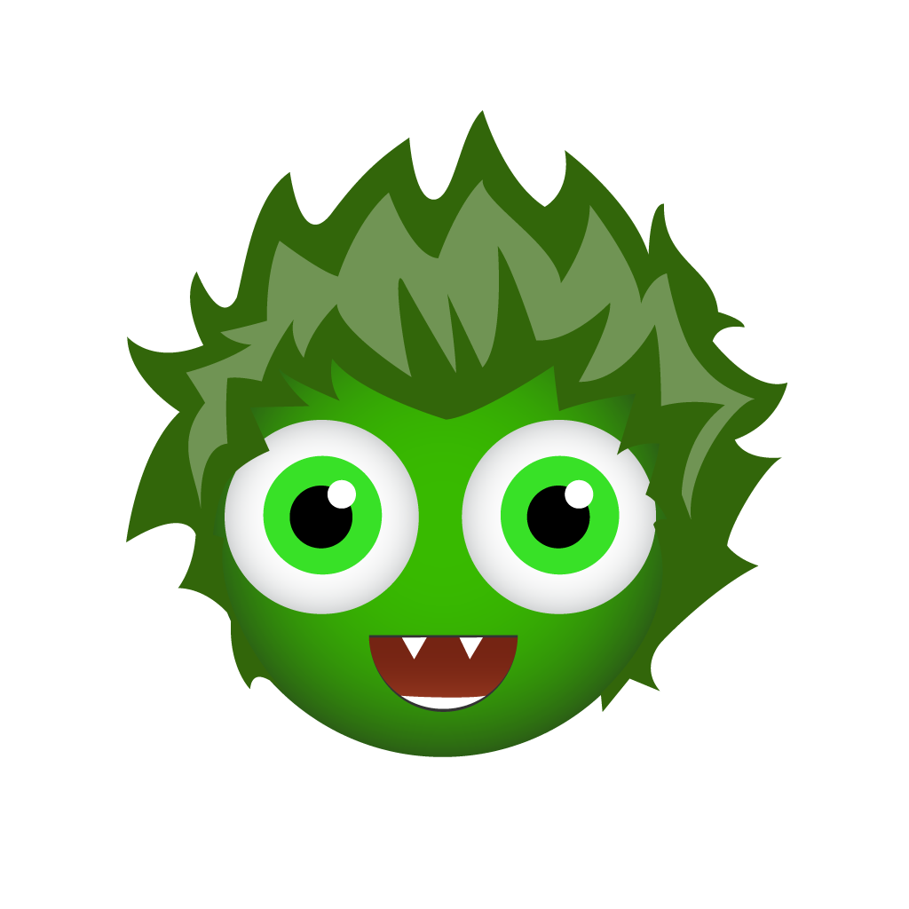
Introduction
BoomReader is the new way we are logging home and school reading.
It has been used by hundreds of schools and thousands of parents, children and teachers since 2020.

Slide 3
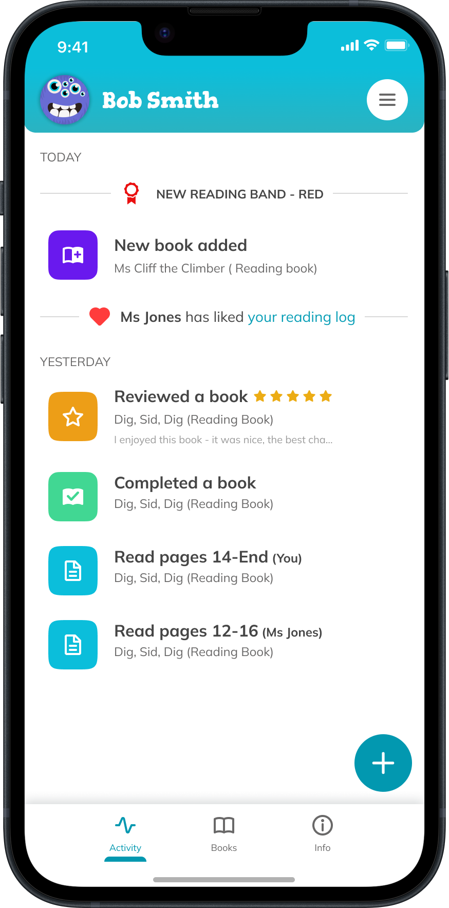
Benefits
No more lost paper reading diaries!
No more damaged paper reading diaries- the ‘water bottle leaked in the bag’ diaries are gone forever!
All reading you log will be saved for the entire time your child is in school so no logs are lost.
Only one parent account needed for your family

Slide 4
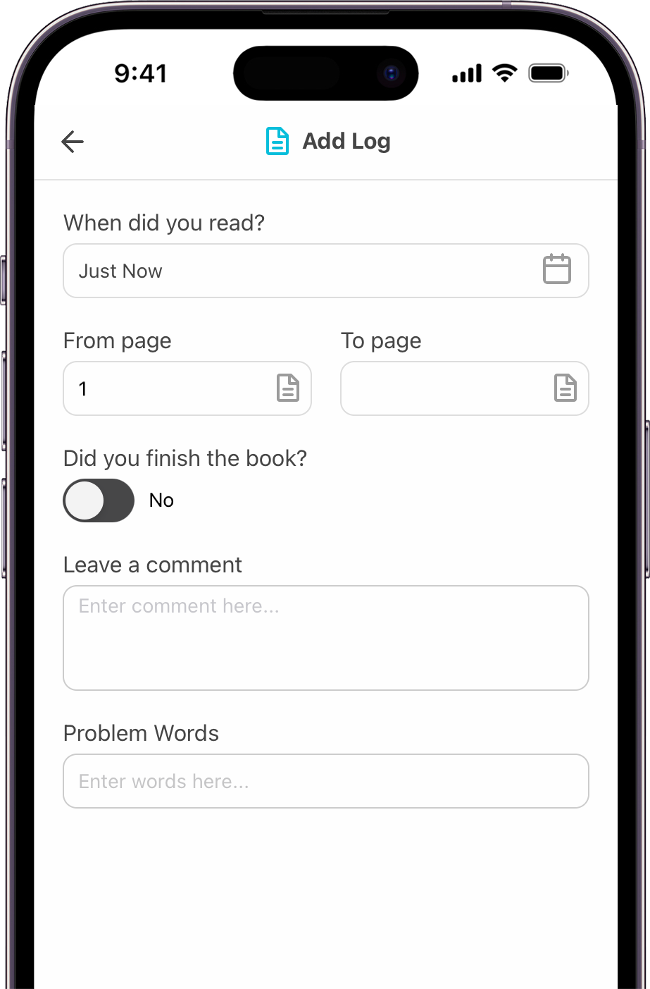
Benefits
Parents/carers can log reading separately
School gains valuable insight into reading across school
You can add reading books and any others from home
The app is free to download
There is a website version too
Reduce use of paper for schools

Slide 5
Getting started
Please use the login details letter sent home by your child’s teacher
Follow the instructions to download the app
Create an account quickly and easily
Connect to your child (with the school code/login code on the letter)
That’s it - you’re all set!
Please use the one page guide for help as needed.

Slide 6
Guide
Activity
You can view and tap on any activity here to see more detail, add logs etc.

Slide 7
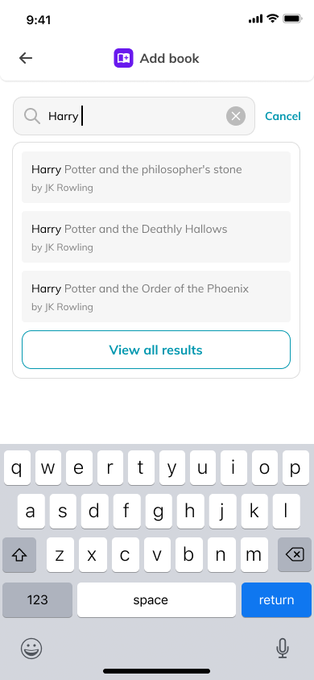
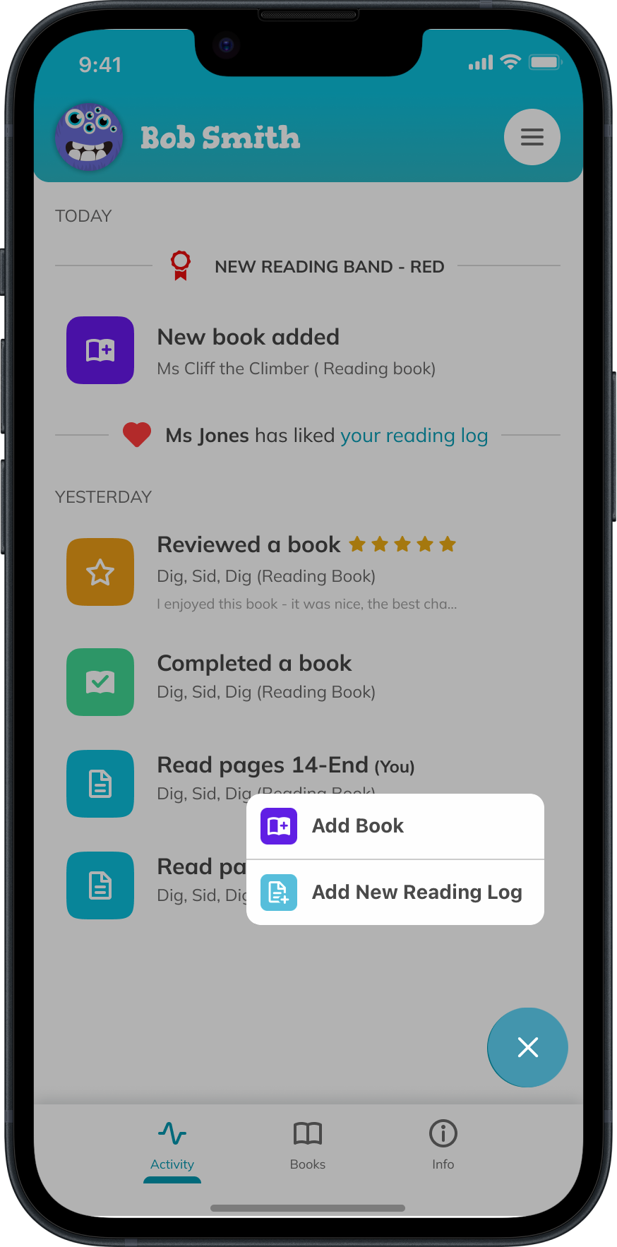
Guide
Add Book
Simply start typing the book title to find your book. You can also add the book title yourself.

Slide 8
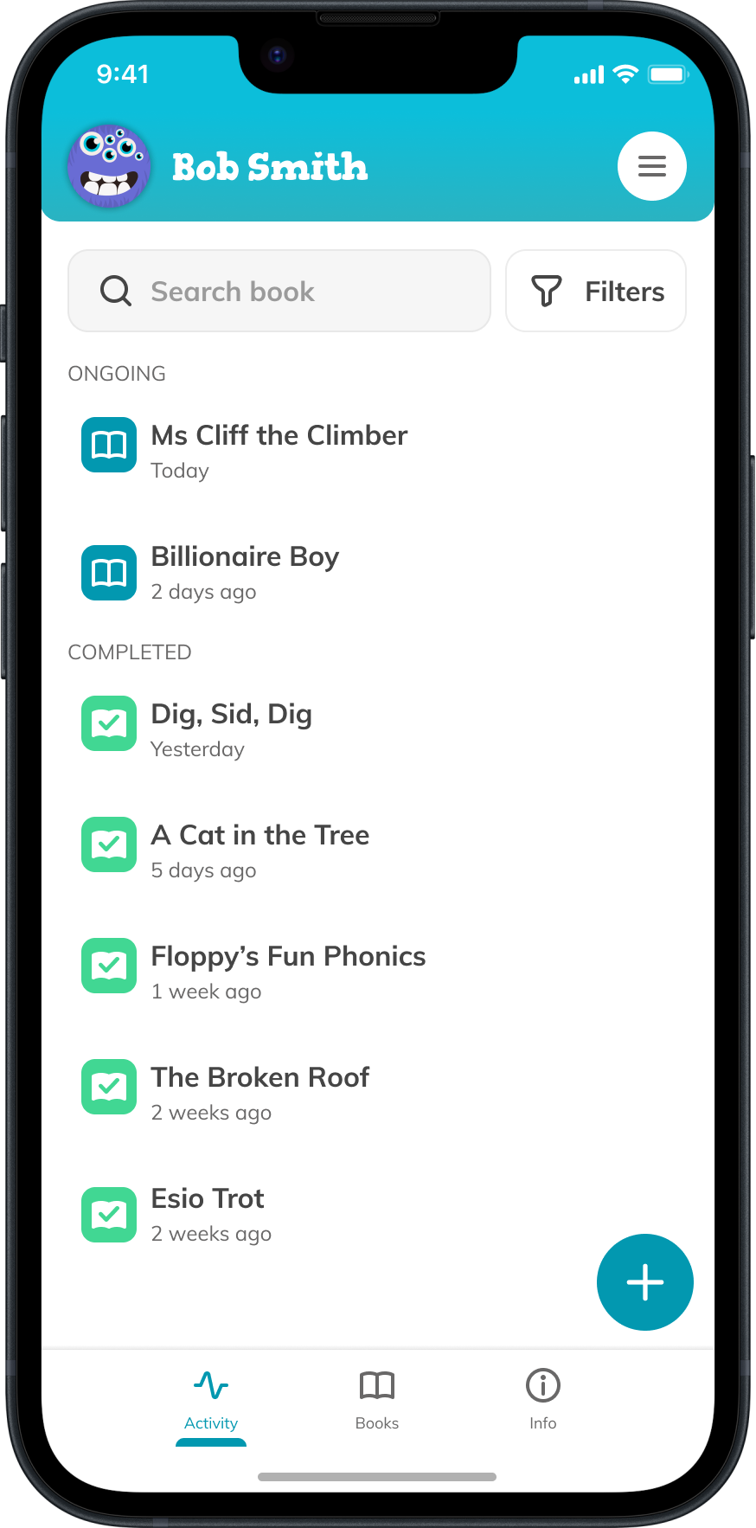
Guide
Books
All current and completed books are listed here.
Tap a book to view the reading history.

Slide 9
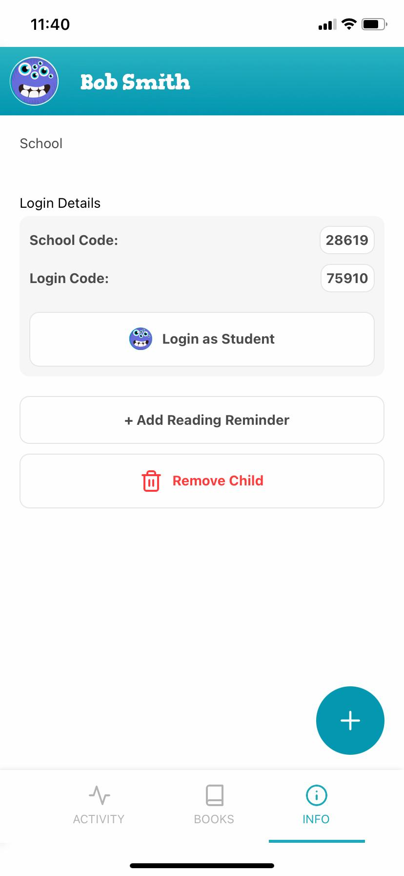
Guide
Info
View your child’s account, add a reading reminder and login as your child to see their avatar and spend their gems.

Slide 10
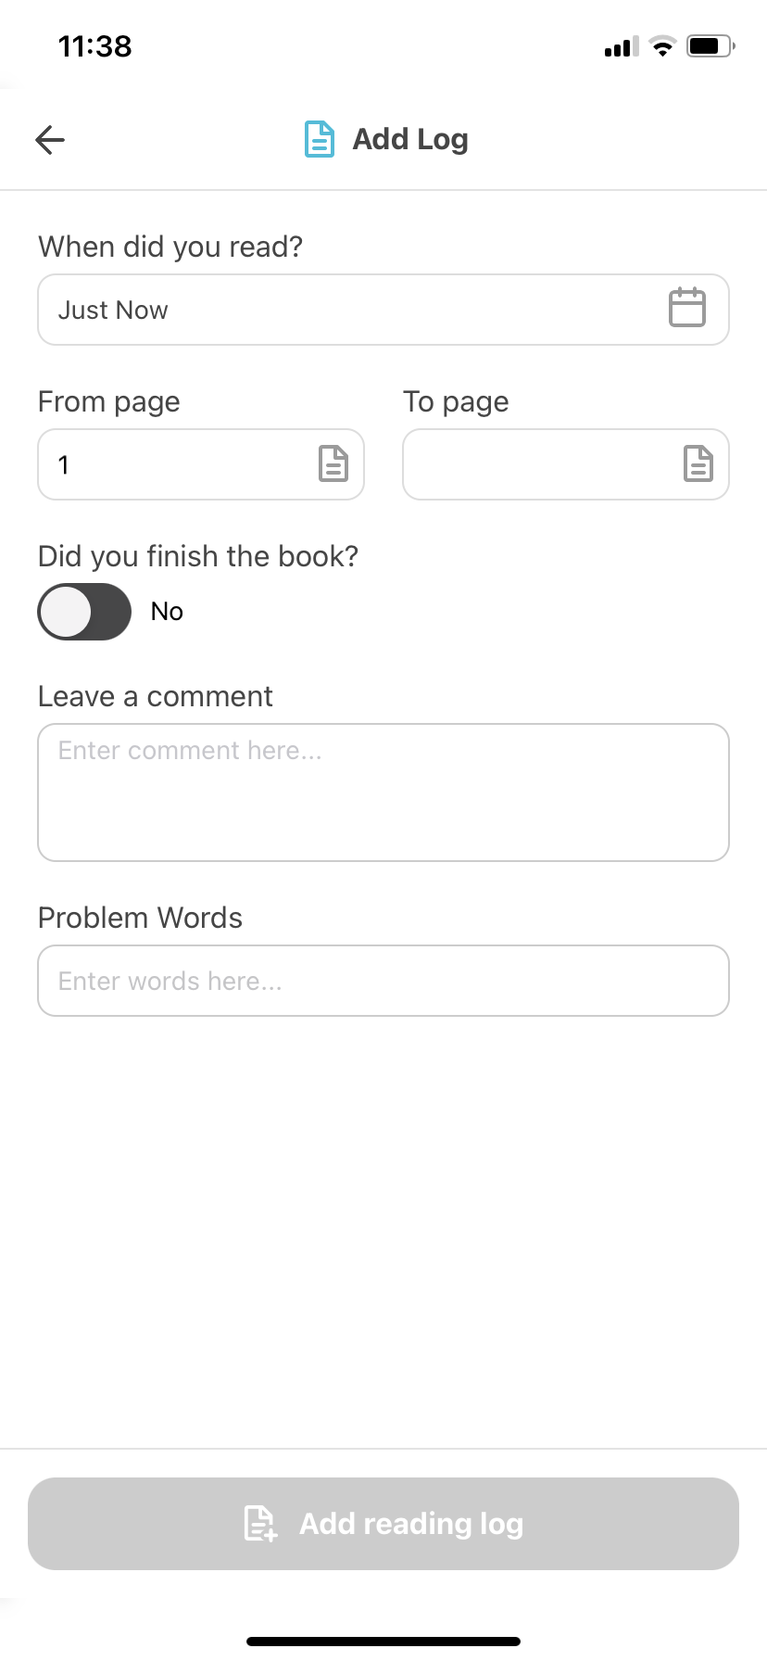
Guide
Add Reading Log
Choose the book and then fill in the log. Minimum requirement is the page number your child read to.
Tap edit log to make make
any changes.

Slide 11
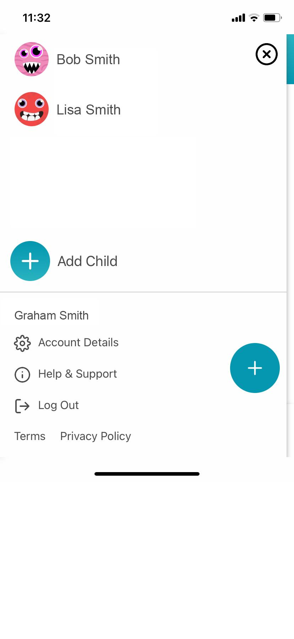
Guide
Menu
Switch quickly between your children and see other account details.

Slide 12
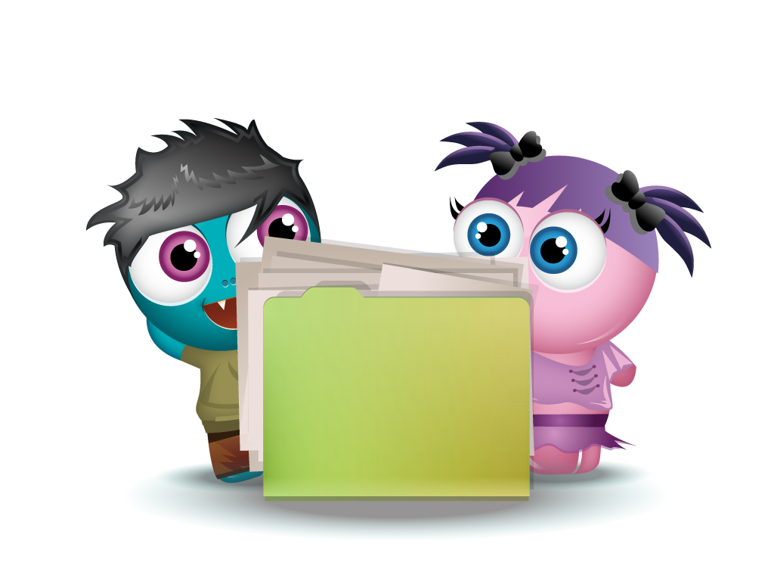
Frequently Asked Questions
Q) I haven’t received the email?
A) Please check junk/spam folders and search for support@boomhub.app and parents@boomhub.app emails (contact BoomReader directly if you are unable to find the email).
Q) How do gems work?
A) The gems are awarded up to twice a day for any reading logs. Gems are also awarded randomly between 1-3 each time, just to keep it a little more interesting for the children than just one each time.

Slide 13
Frequently Asked Questions
Q) Can I login as my child to look at their avatar/gems?
A) Yes- parents can login as their child on the app and have fun with the avatar creator and reward cards
Q) I need help!
A) No problem - please email parents@boomhub.app for support.

Slide 14
Thank you for your support!

